Slide 1
3D Printing
By Emily Smith

Slide 2
What is 3D printing?
Process of creating using a three dimensional digital model to create a physical object by producing several thin layers in a sequence.
Rhino is a CAD program that is used to create 3D prints.

Slide 3
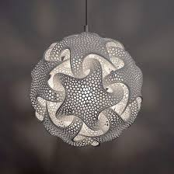
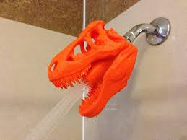
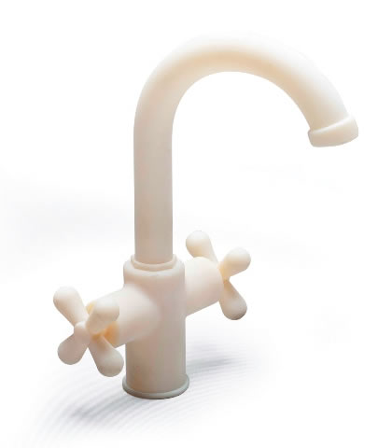
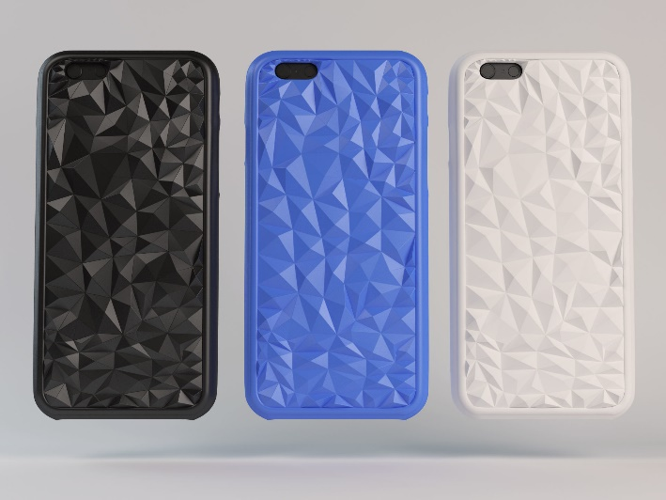
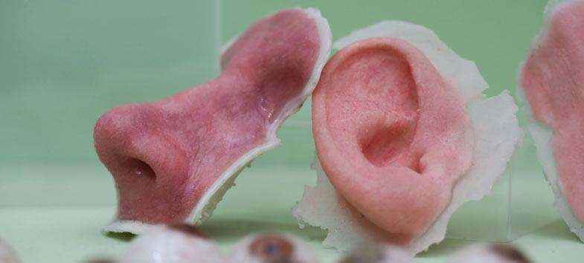
3D Printing Now
Medical
Engineering
Parts and tools
“Green”
Commercial products
Emotional marketing
Art

Slide 4
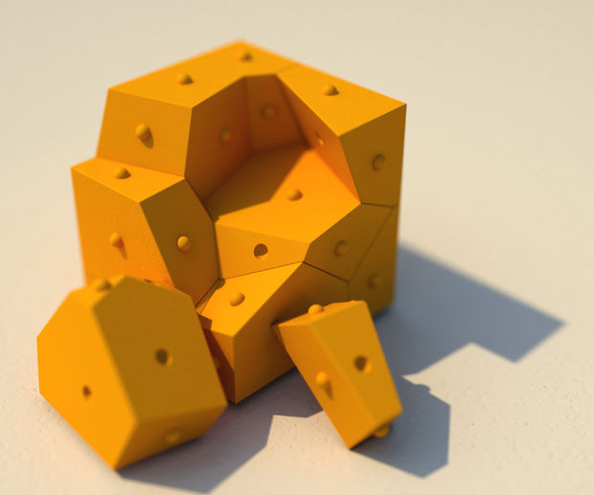

Slide 5
Ideation
Draw two sketches of how you might want to deign your puzzle piece.
You will be working in groups of 3 each one will be assigned a specific attachment from my puzzle piece to build off of
Draw to scale
Include a minimum of 4 possible cuts in a 50.4mm x 50.4mm x 50.4mm square
Minimum of 3 spheres (15mm x 15mm x 15mm) one added and one subtracted
Record measurements on sketches and for model of where things are placed
Discuss designs with classmates to figure out how pieces can fit together.
Keep in mind these elements and principles of design to help with design ideas: shape, form, space, line, movement, perspective, unity
Record ALL measurements!
Choose one sketch recreate in a 3D model using clay
Make it scale
Work with other classmates see if pieces fit together and make modifications.

Slide 6
History of 3D Printing
3D Printing was invented in the 1980’s and was mainly used for producing scale models and industrial use.
In the 1990s the patents industrial companies had on 3D printers expired and the start of 3D printing for consumers began to grow.

Slide 7
3D printing and Art
https://youtu.be/IS4Xw8f9LCc

Slide 8
Josh Harker
“My art is about pushing the limits of form & dimensions to share my visions… an exploration into what can be made & how to accomplish it in effort to tell a story or create an experience. I incorporate digital tools, software, & technology as well as traditional mediums in my work to create art that is both exciting & engaging.”
Josh Harker
https://youtu.be/-C3ag6u4NsI
https://youtu.be/I22scdVR4pc

Slide 9
Bathsheba Grossman
Explores art and mathematics
Always finding beauty in geometry and working with symmetry and balance

Slide 10
Rob and Nick Carter’s Replica of Vincent van Gogh’s Sunflowers.

Slide 11
Project EGG
4,760 uniquely shaped 3D printed stones
Largest 3D printed collaborative project
Created by people from all over the world

